Slide 1
2025 Hydropower Collegiate Competition (HCC)
Noah Dilworth
Jennifer Edgar
Robert Ginieczki
Benjamin Tushingham

Slide 2
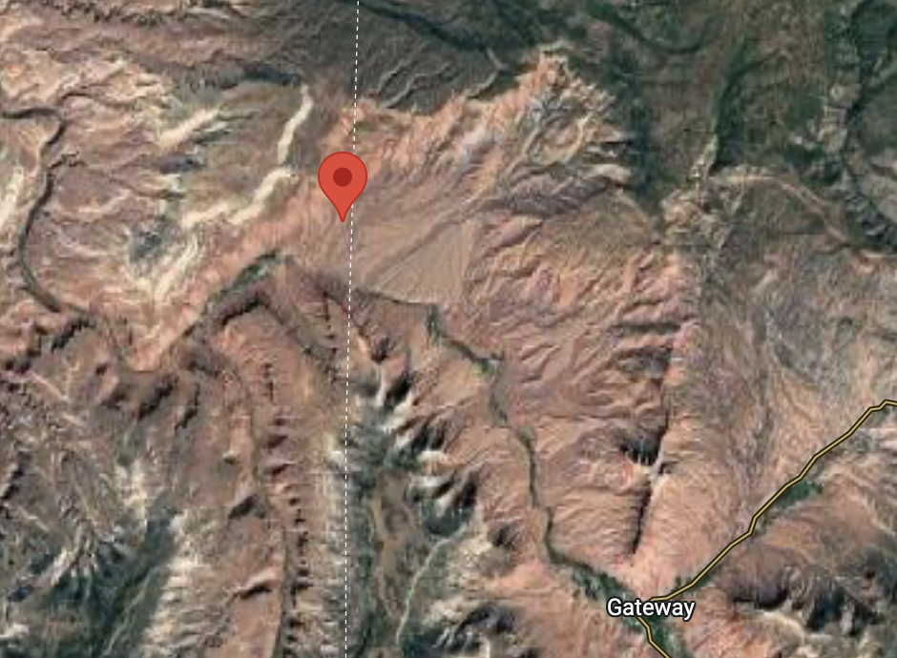
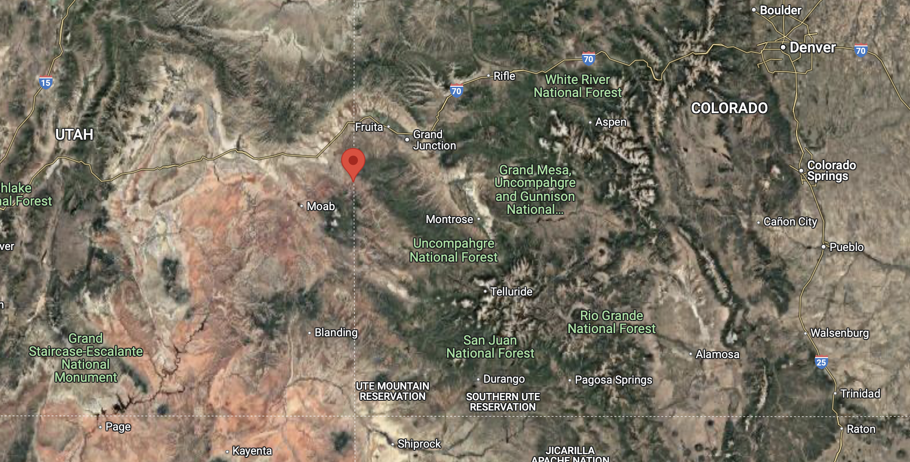
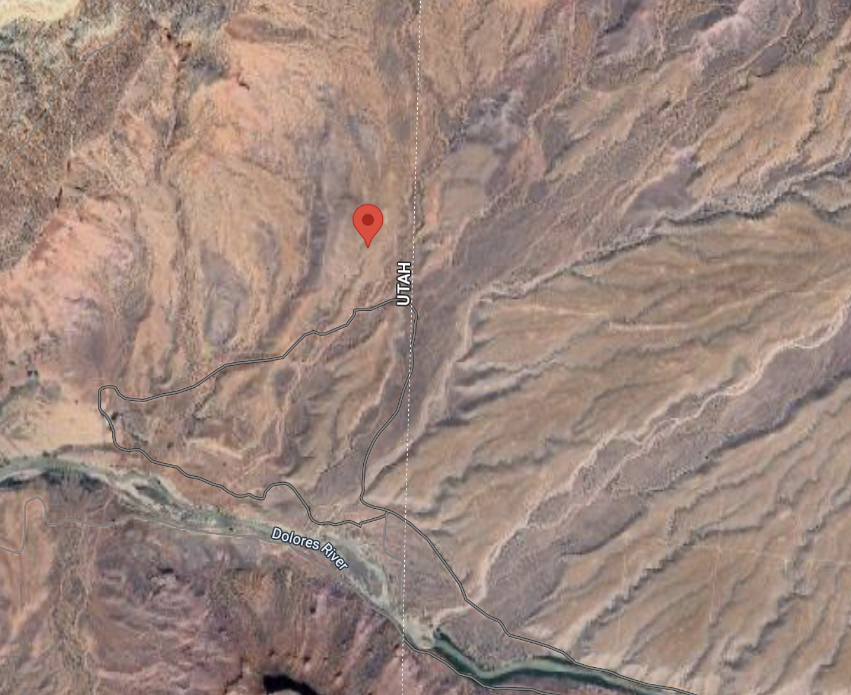
SITE BACKGROUND
Figure 2: Site Closer Up
Figure 1: Site Selection
Figure 3: Site Even Closer Up

Slide 3
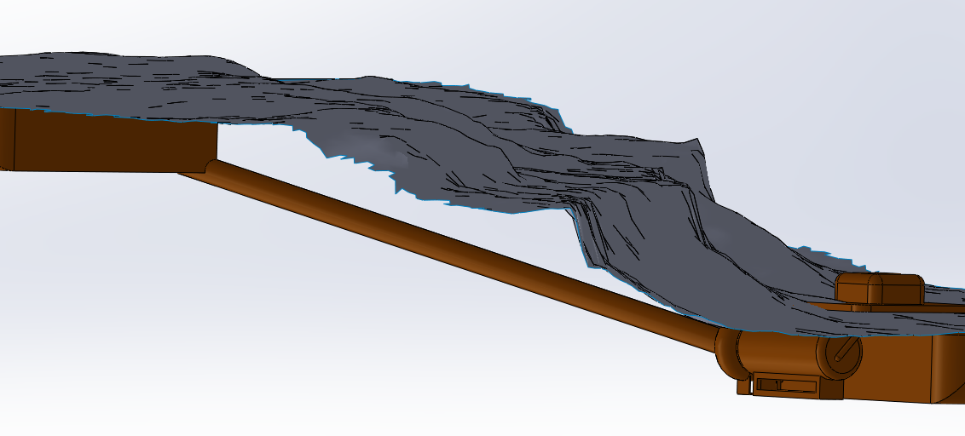
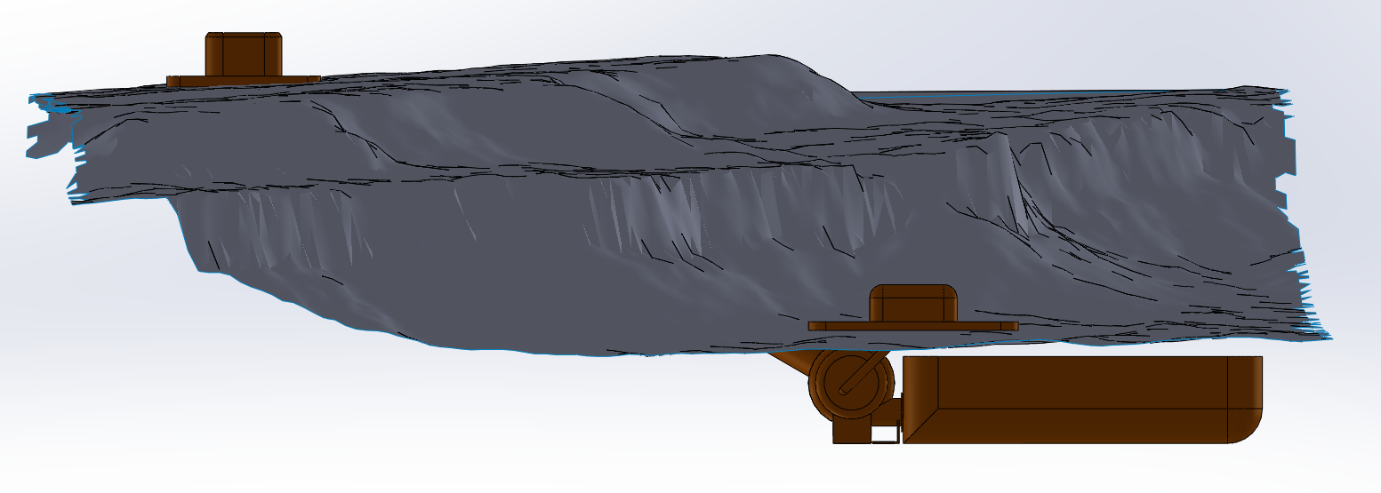
VIRTUAL PROTOTYPE
Figure 4: Site Topography With Design Components
Figure 5: Site Topography Front View

Slide 4
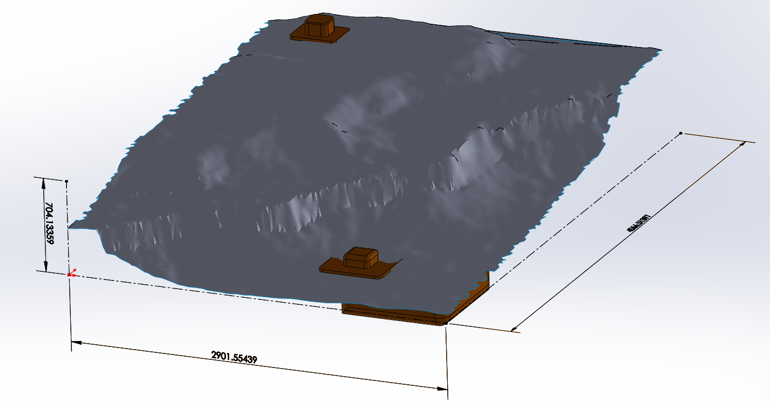
Scaling/Dimensioning
Figure 6: Site Topography With Design Components

Slide 5
Virtual Prototype
Questions
Answers
Will our chosen site work with our current design? What will the theoretical site look like within our site?
Methods and manufacturing used?
Results?
How will this change the future plans for the project?
Team Members?
The current modeling looks like the topography will be able to support the needed requirements.
We used SolidWorks for the creation of the CAD and imported the topography from ArcGIS
The results of this modeling have helped us to determine what our design will look like within the topography of the current site.
For the future we will need to determine if this topography will allow for the correct parameters, we need to have a competitive design.
Team members: Jennifer and Noah

Slide 6
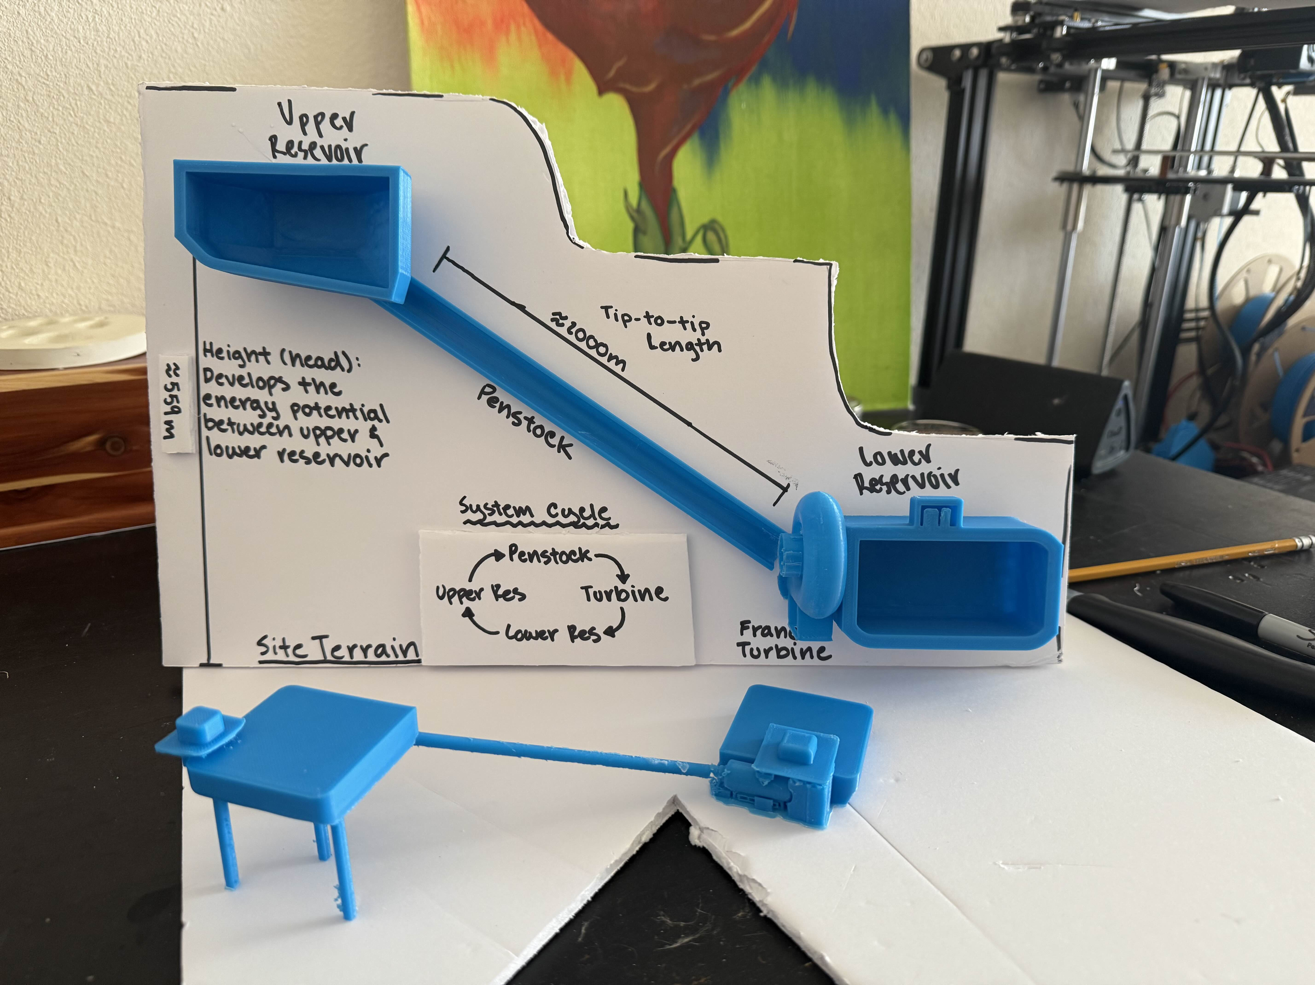
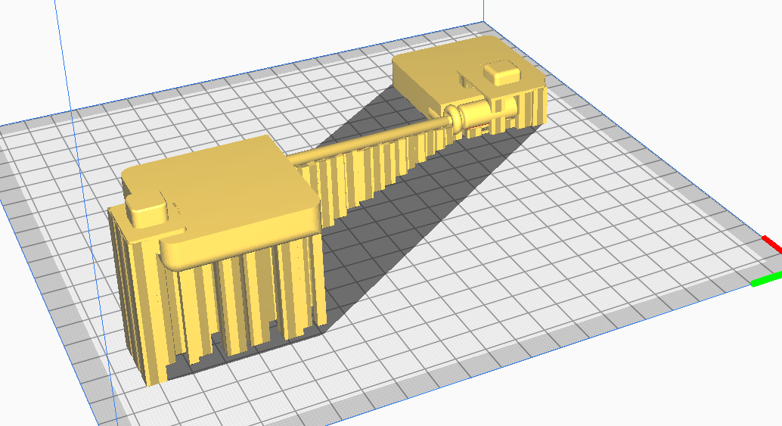
Physical Prototype
Figure 8: Physical Prototype Print
Figure 7: Physical Prototype

Slide 7
Physical Prototype
Questions
Answers
Will our chosen site work with our current design? What will the scaling of the site look like for the competition?
Methods and manufacturing used?
Results?
How will this change the future plans for the project?
Team Members?
Currently, the design looks like it will work for all our needed components and will be able to be scaled down appropriately.
We used SolidWorks and 3D printing for the physical design along with additional pieces such as the foam board to create the topography
This gives us a good idea of how we need to move forward with our build and test model for the competition. The model has showed that all our design will work with our site selection.
We will need to find a different way for the topography to be represented as currently it is too complex for our available 3D printer.
Team members: Robert and Benjamin

Slide 8
Thank You!

